Slide 1
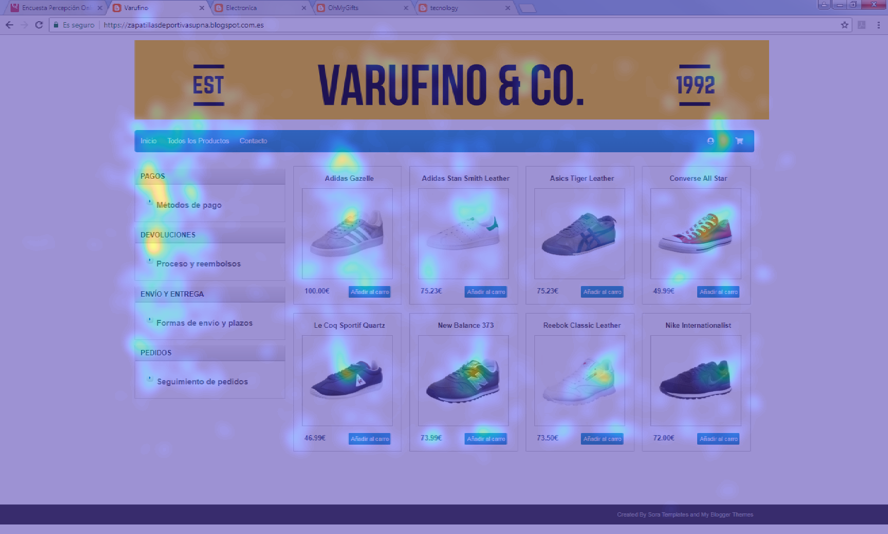
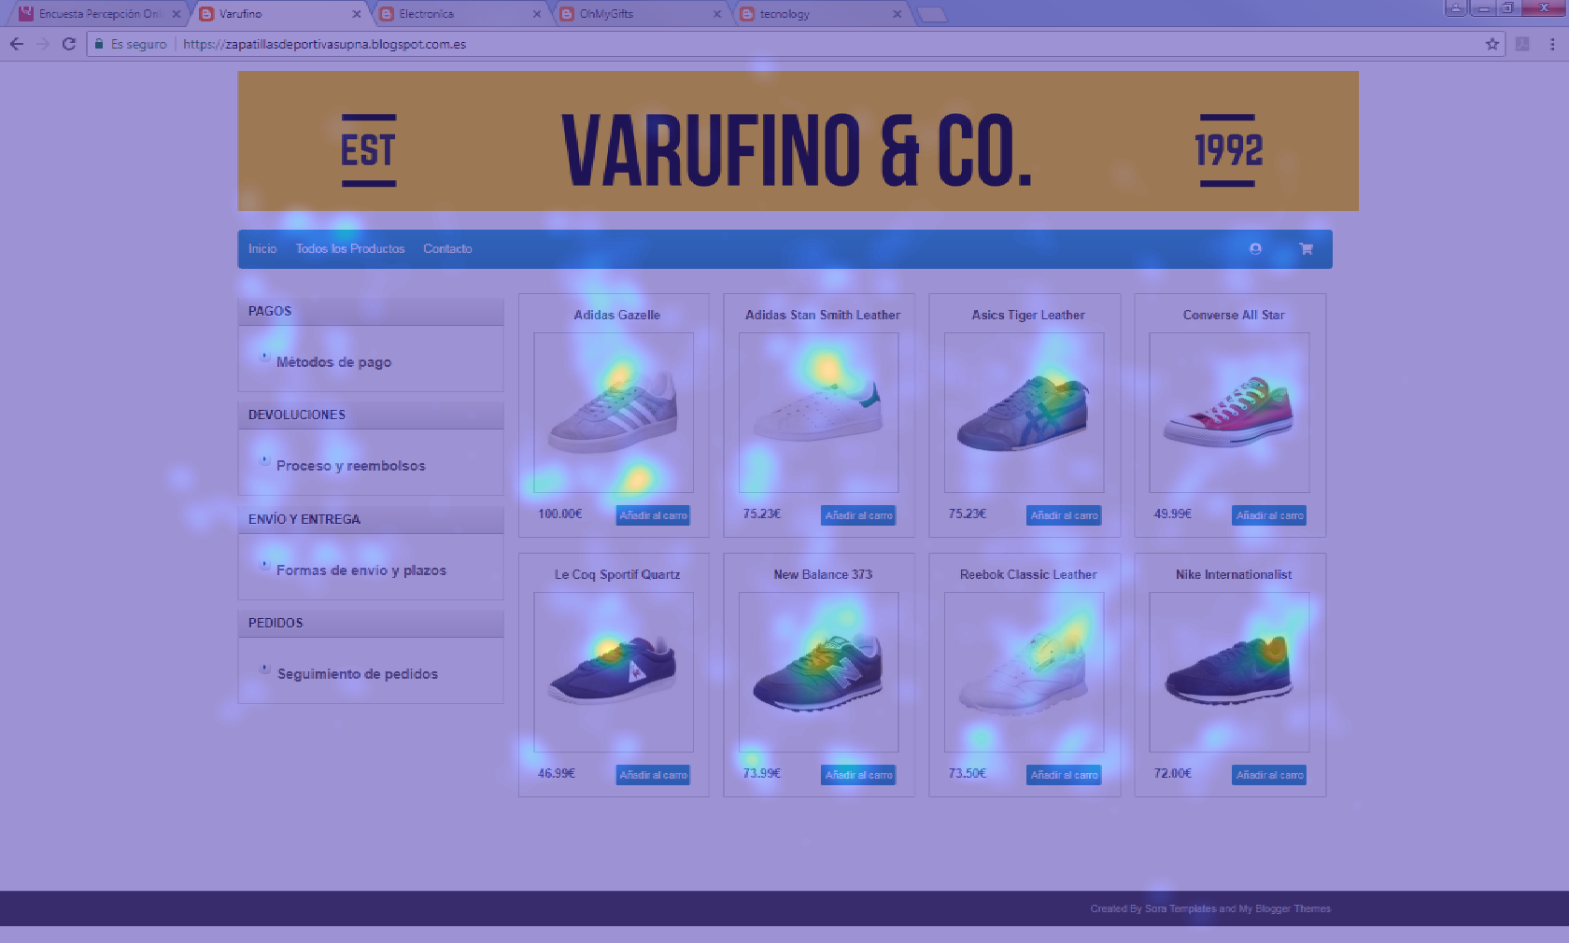
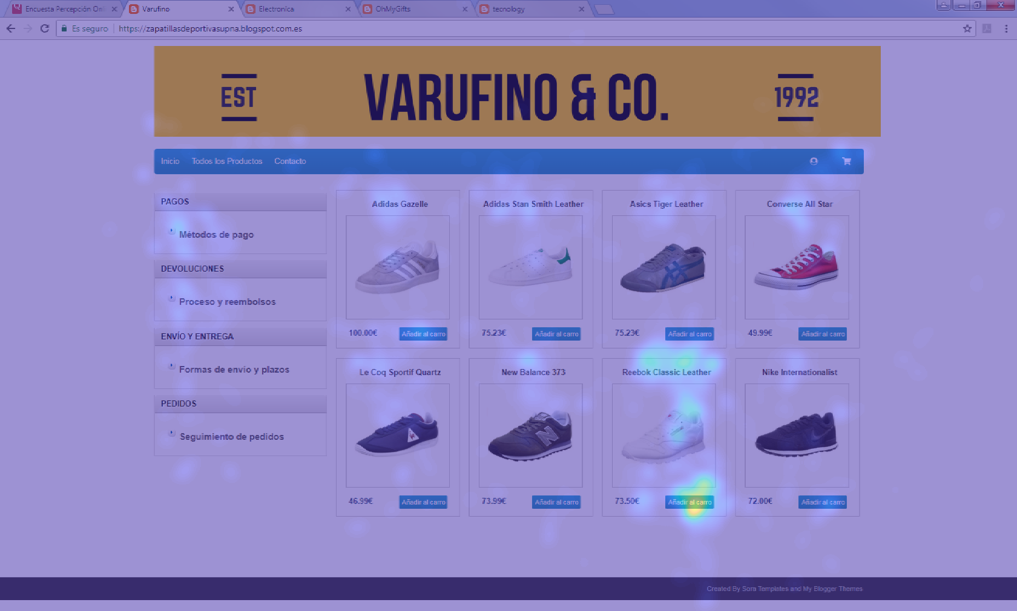
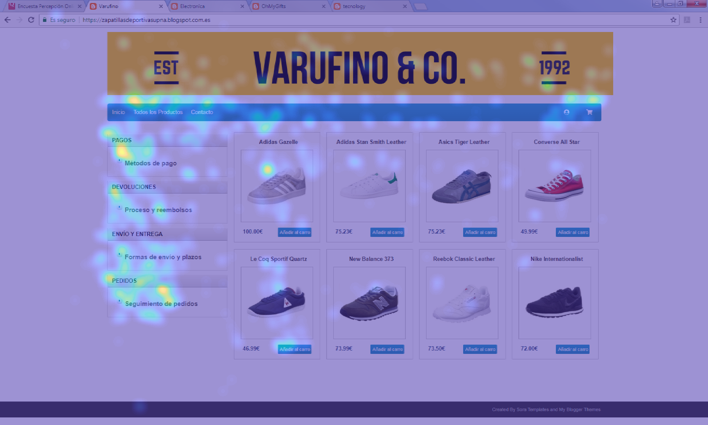
TASK 1: WEB EXPLORATION
TASK 2: PRODUCT EVALUATION
TASK 3: PRODUCT PURCHASE
TASK 4: POST-PURCHASE

Slide 2
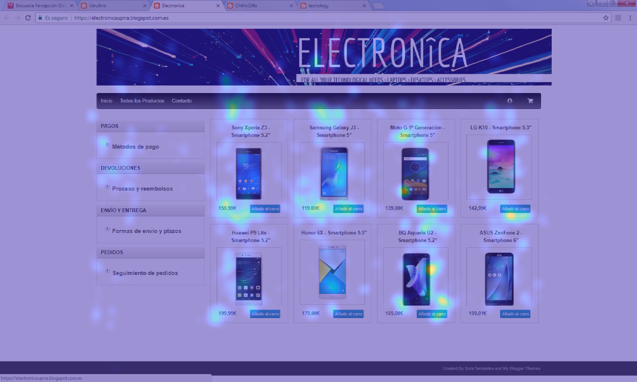
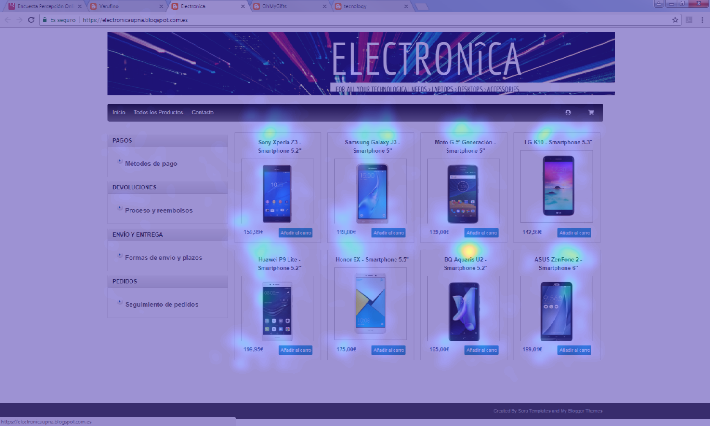
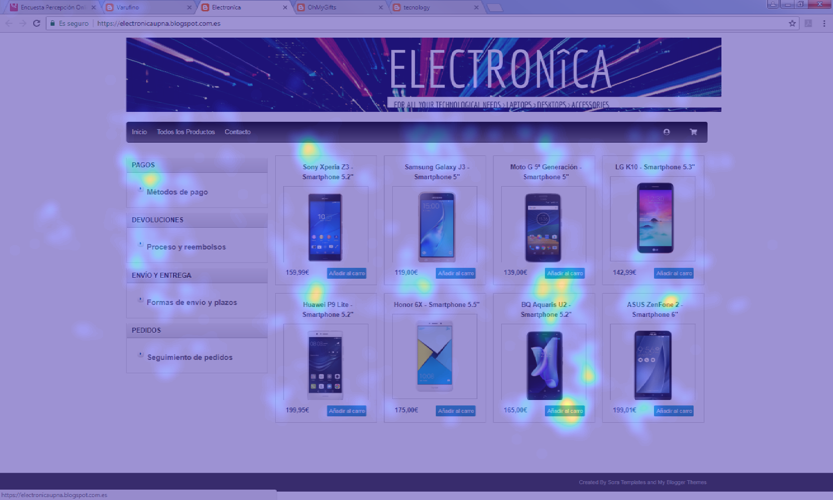
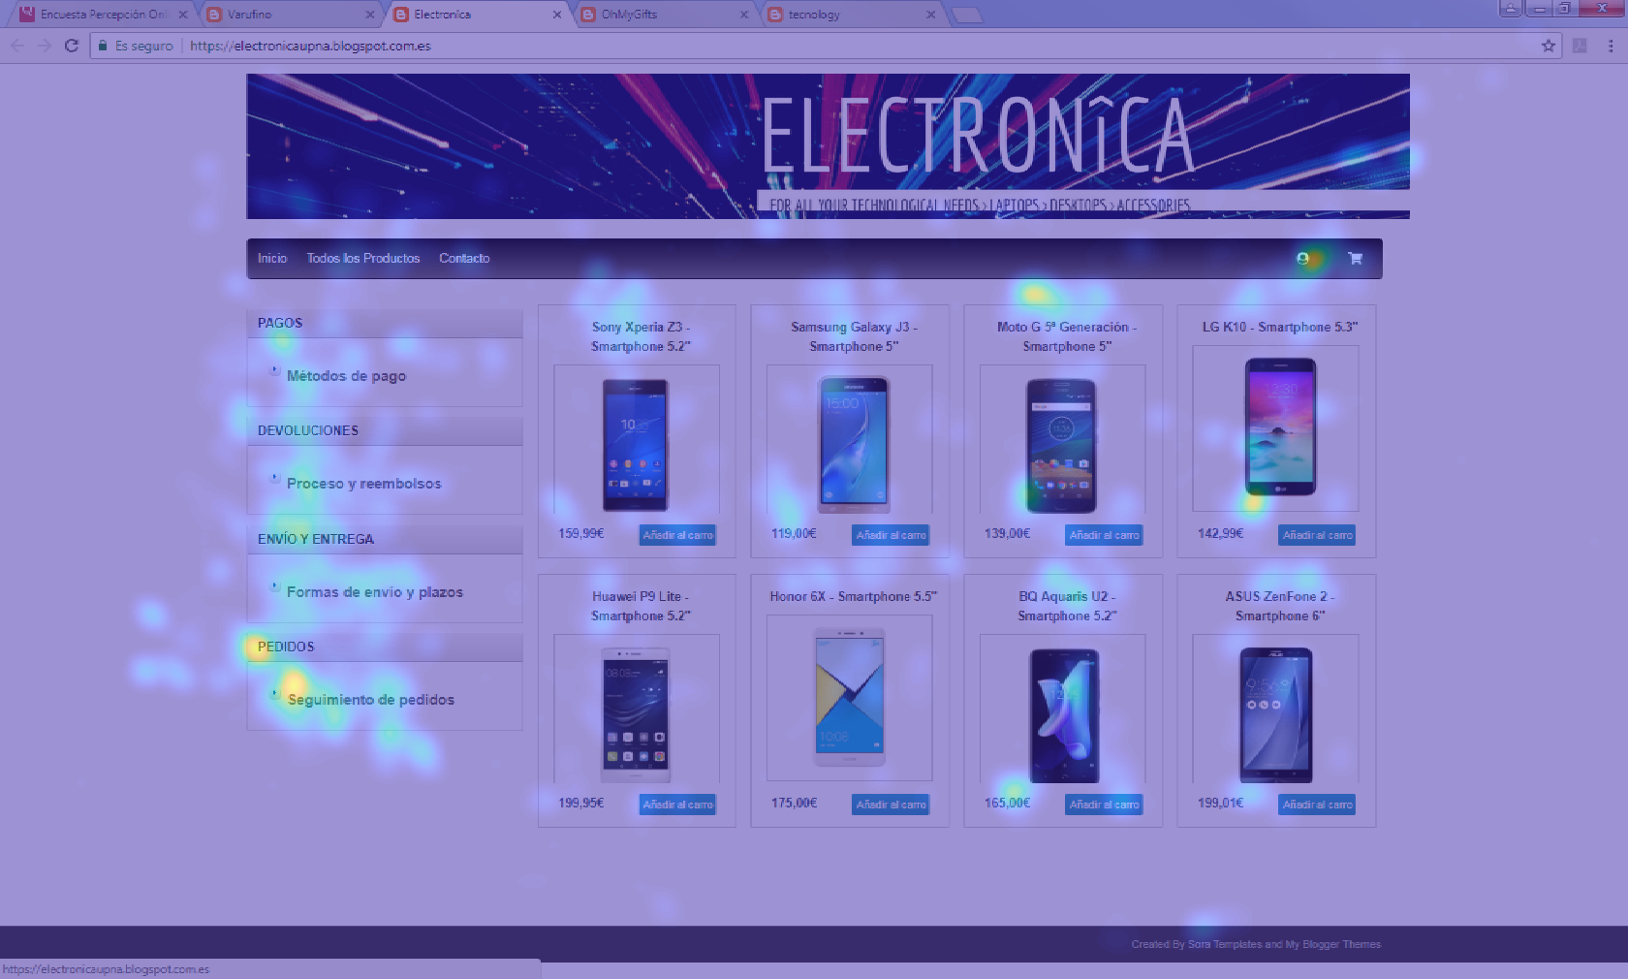
TASK 1: WEB EXPLORATION
TASK 2: PRODUCT EVALUATION
TASK 3: PRODUCT PURCHASE
TASK 4: POST-PURCHASE

Slide 3
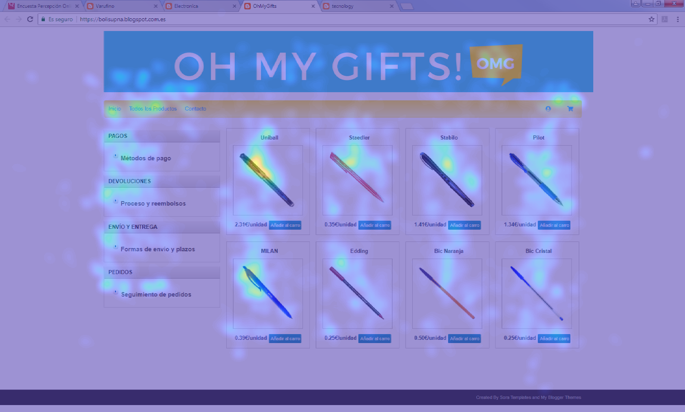
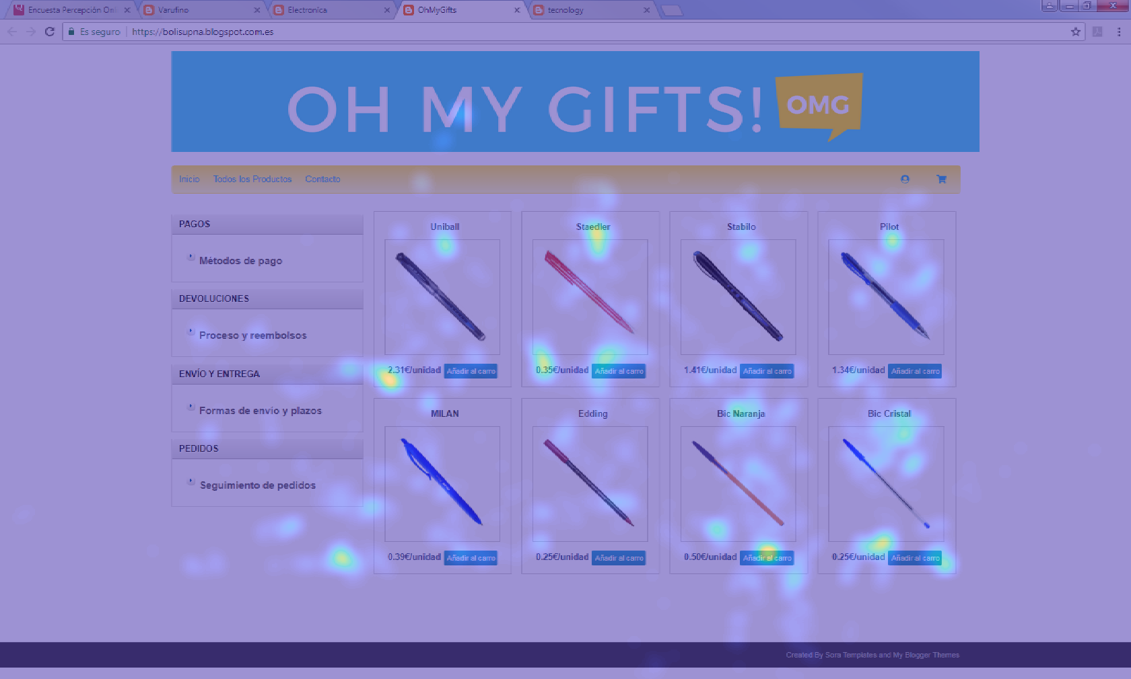
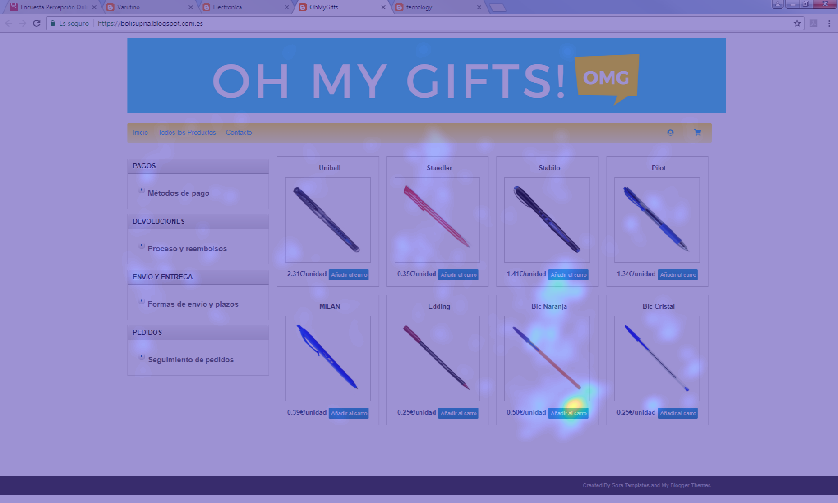
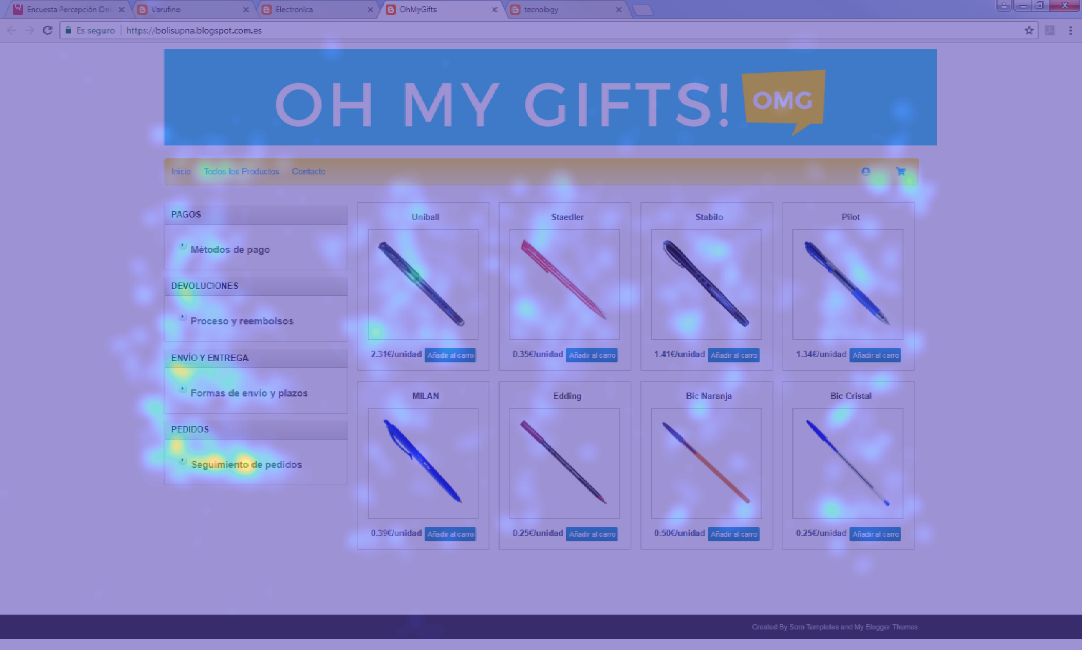
TASK 1: WEB EXPLORATION
TASK 2: PRODUCT EVALUATION
TASK 3: PRODUCT PURCHASE
TASK 4: POST-PURCHASE

Slide 4
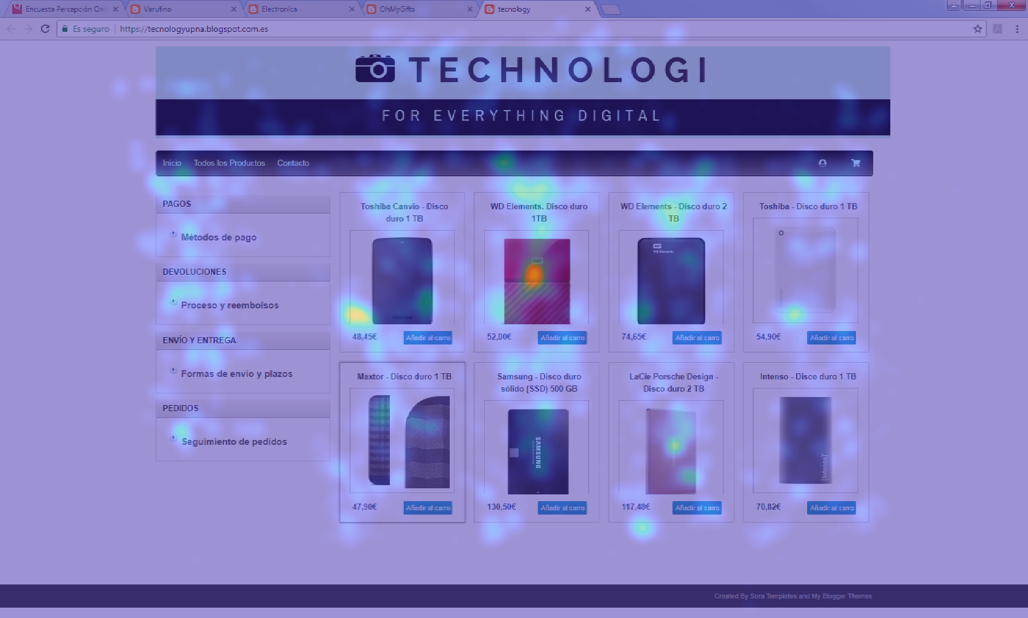
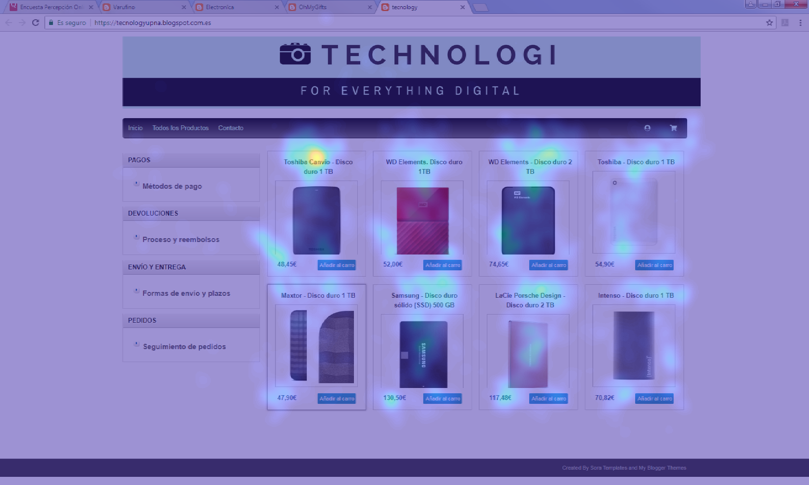
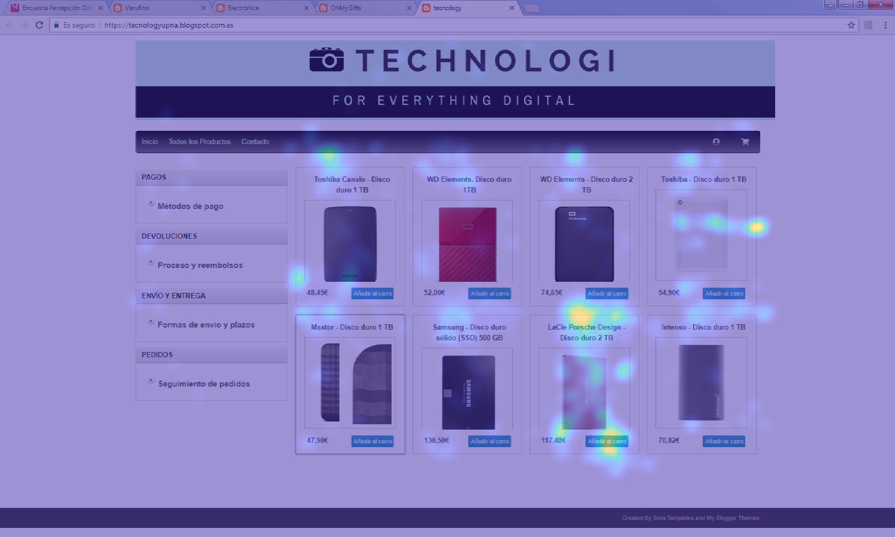
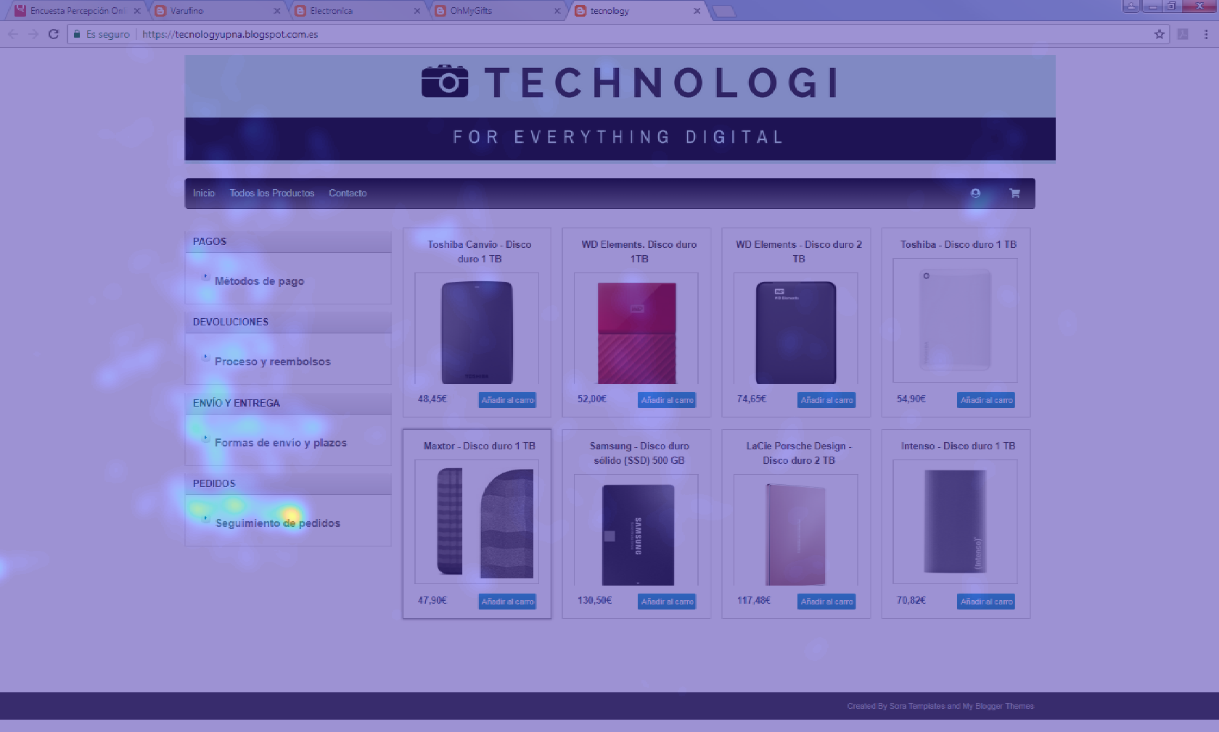
TASK 1: WEB EXPLORATION
TASK 2: PRODUCT EVALUATION
TASK 3: PRODUCT PURCHASE
TASK 4: POST-PURCHASE

